Slide 1

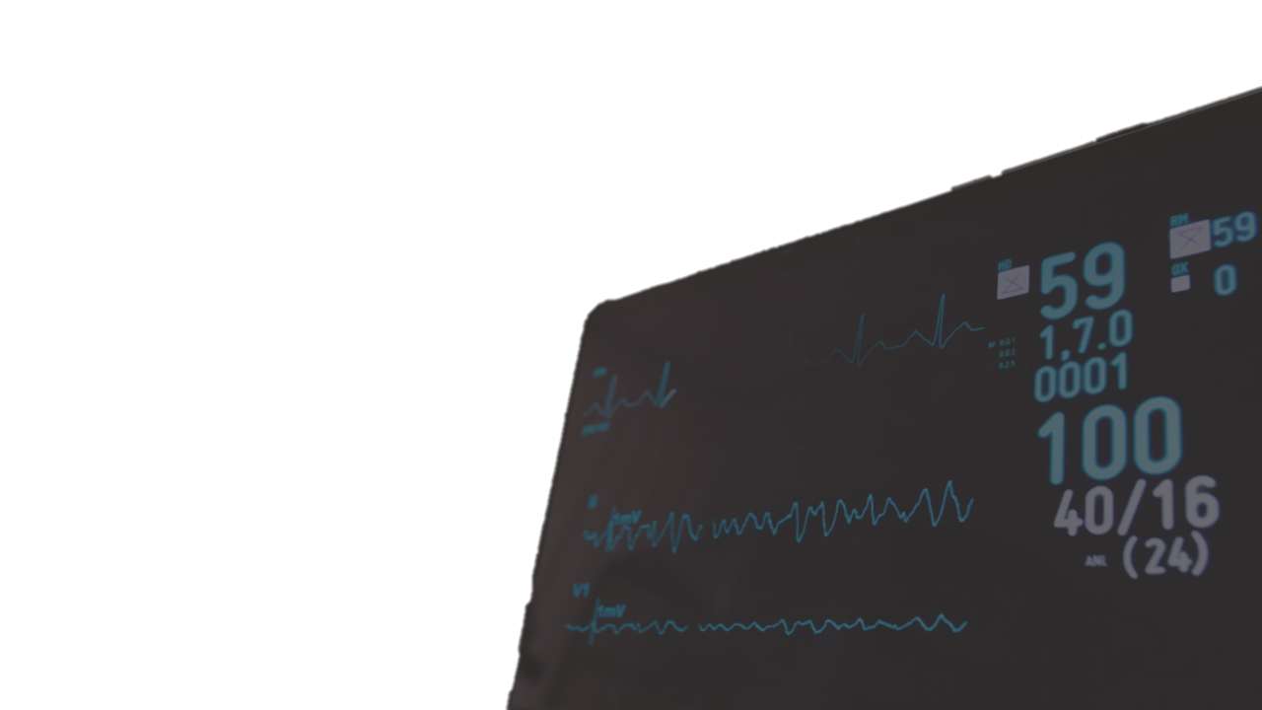

Long-term
Atrial Fibrillation Detection
Presented by Ali Tabaraei
Under the supervision of
Prof. Roberto Sassi and Massimo Walter Rivolta

Slide 2
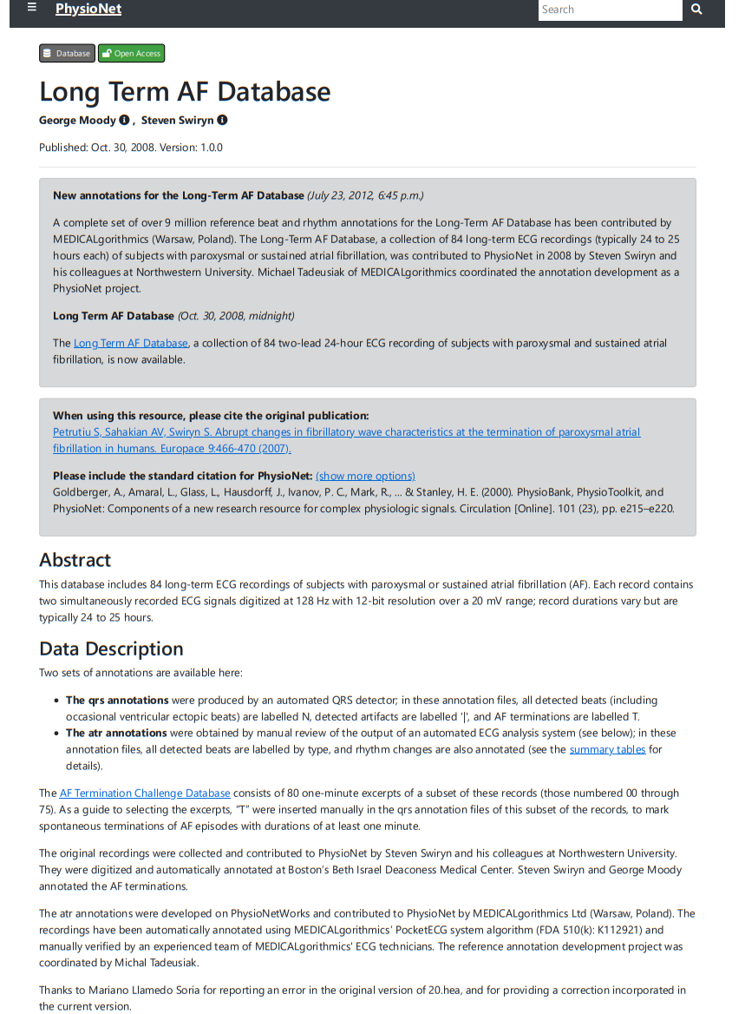
LTAF database
Long-term
Atrial Fibrillation Detection
84 long-term ECG recordings of subjects with paroxysmal or sustained atrial fibrillation (AF)
Typically 24 to 25 hours long each
Two-lead ECG signals digitized at 128 Hz with 12-bit resolution over a 20 mV range
Presented by Ali Tabaraei
Under the supervision of
Prof. Roberto Sassi and Massimo Walter Rivolta

Slide 3

LTAF database
84 long-term ECG recordings of subjects with paroxysmal or sustained atrial fibrillation (AF)
Typically 24 to 25 hours long each
Two-lead ECG signals digitized at 128 Hz with 12-bit resolution over a 20 mV range

Slide 4
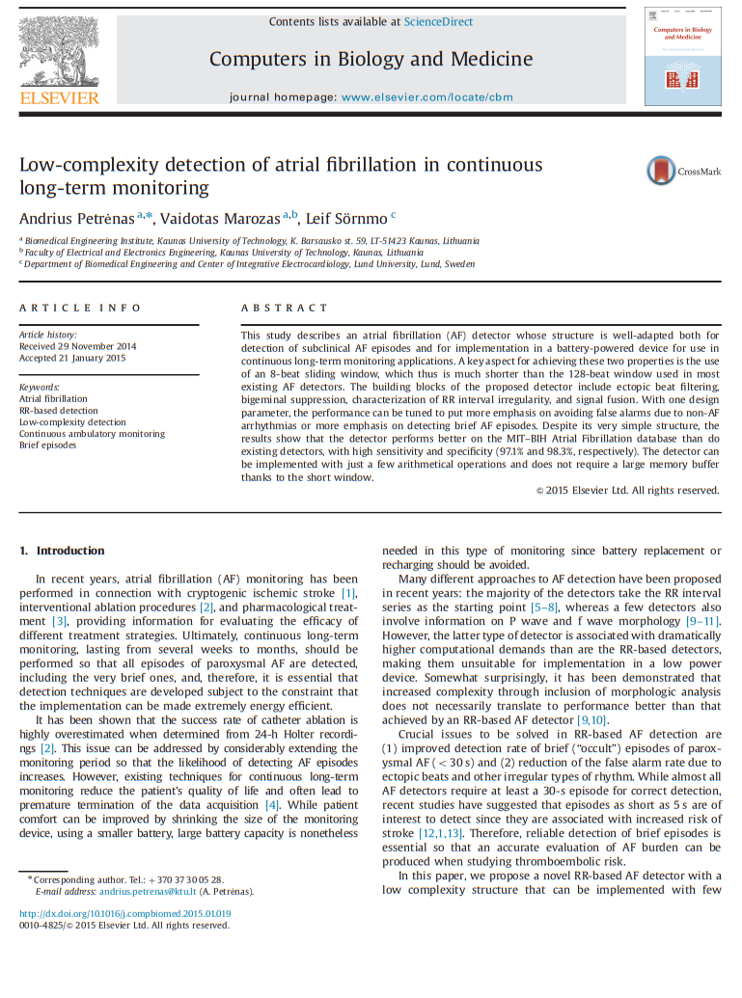
Paper 2

Slide 5
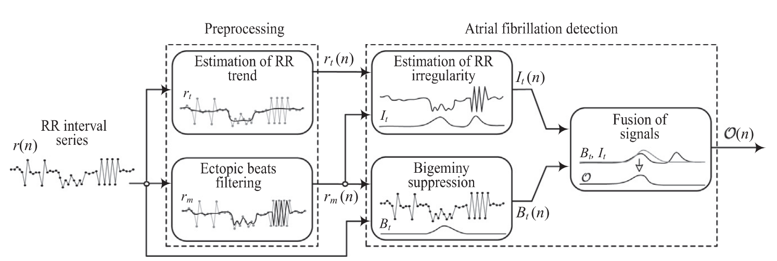
Heart Rate Variability
Characterizing the RR series

Slide 6
Step 1
Heart Rate Variability
Characterizing the RR series

Slide 7
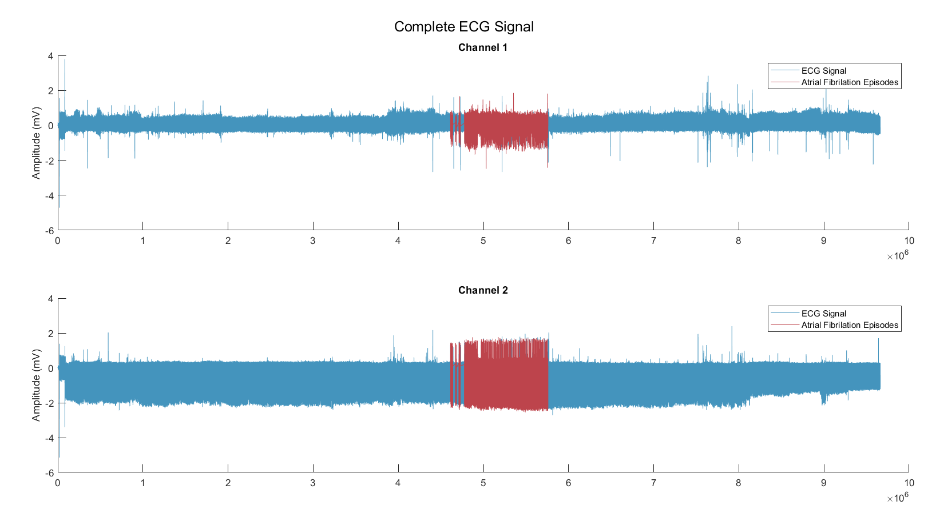
Step 1
Heart Rate Variability

Slide 8
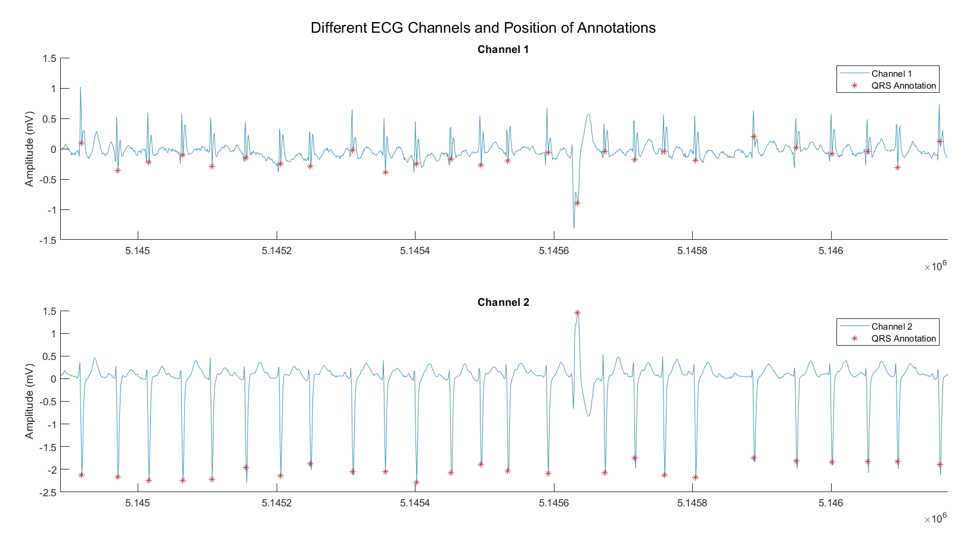
Step 1
Heart Rate Variability

Slide 9
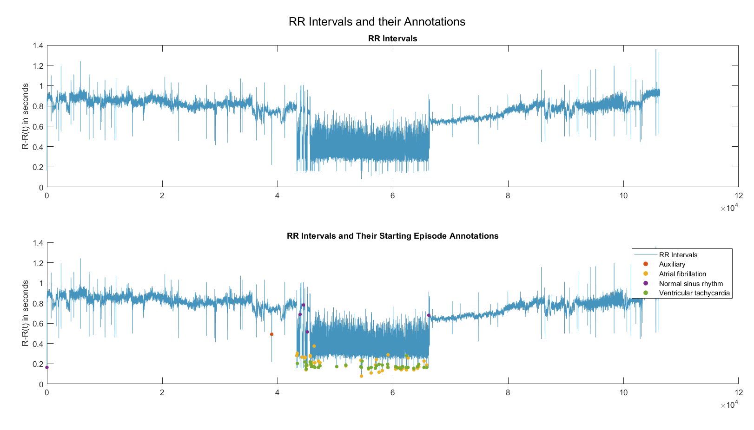
Step 1
Heart Rate Variability

Slide 10
Heart Rate Variability
Characterizing the RR series

Slide 11
Step 2
Preprocessing
3-Point Median Filter and
Forward-Backward Exponential Averager

Slide 12
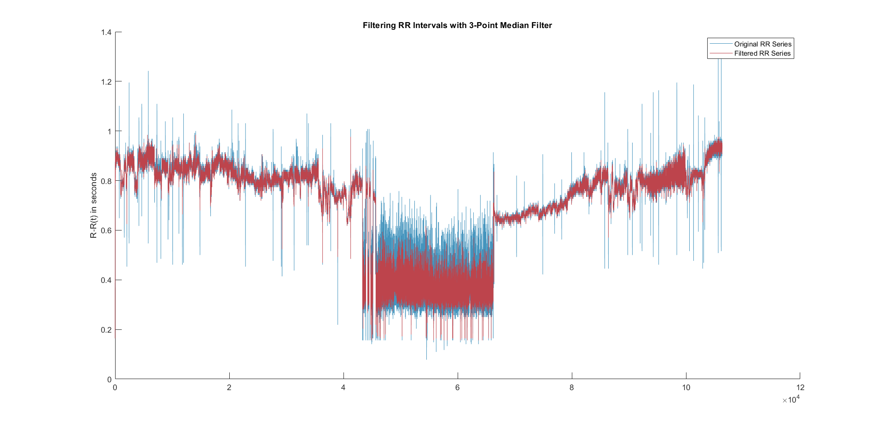
Step 2
3-Point Median Filter

Slide 13
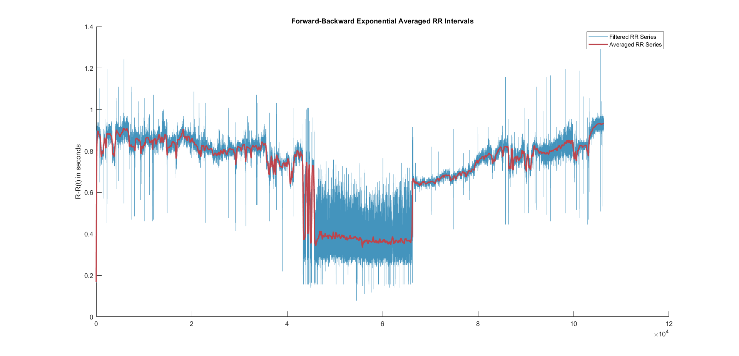
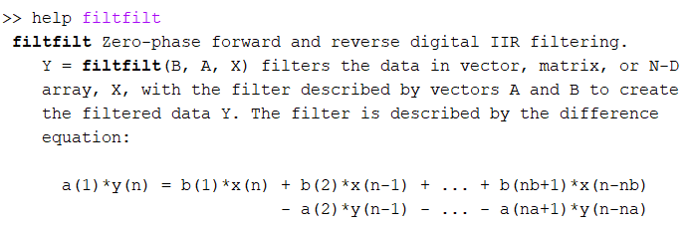
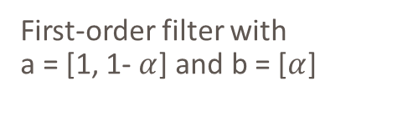
Step 2
Forward-Backward Exponential Averager
$$y\left(n\right)=\left(1−α\right)\text{⋅}y(n−1)+α\text{⋅}x\left(n\right)$$
First-order filter with
a = [1, 1- $α$] and b = [$α$]

Slide 14
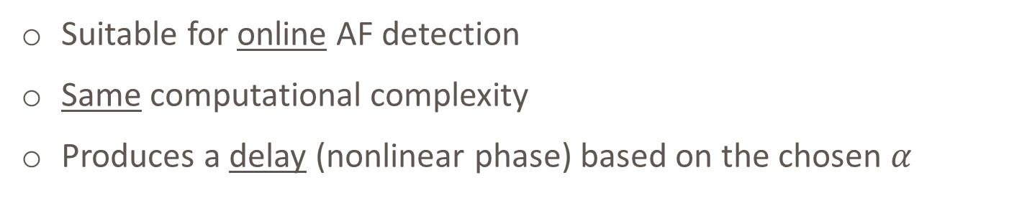
Forward Filtering and
2nd Order Exponential Averager
Step 2
Suitable for online AF detection
Same computational complexity
Produces a delay (nonlinear phase) based on the chosen $α$

Slide 15
Heart Rate Variability
Characterizing the RR series

Slide 16

Step 3
AF Detection
Calculation of I$t$, B$t$, and O

Slide 17
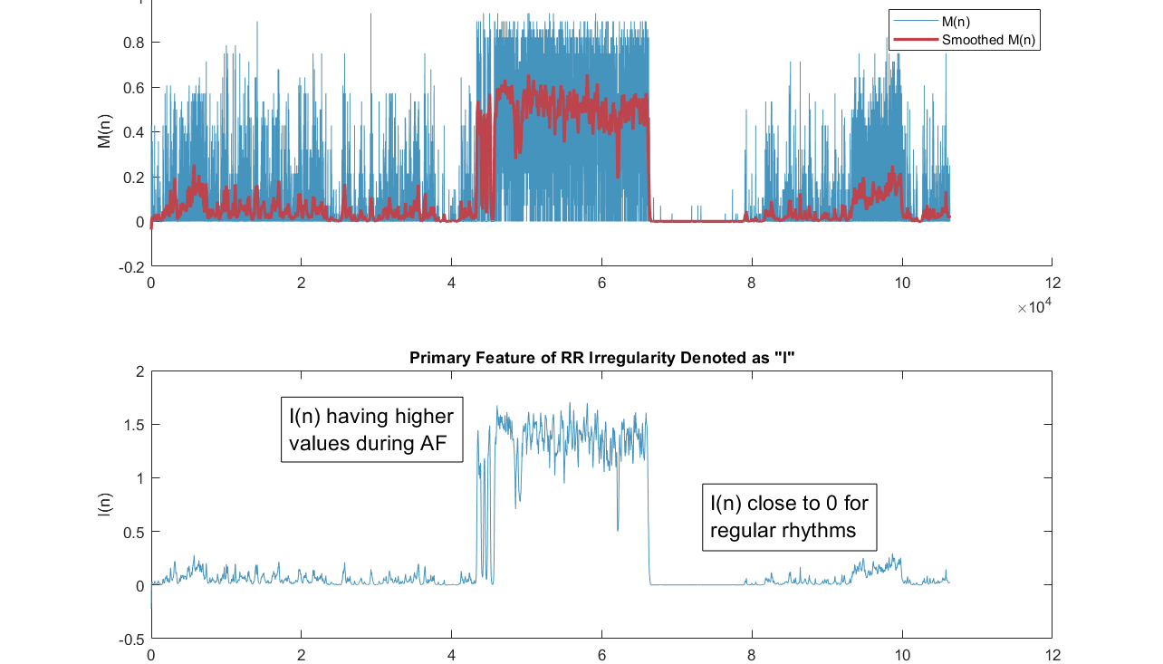
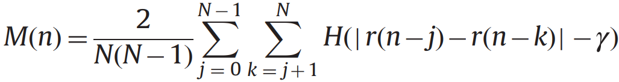
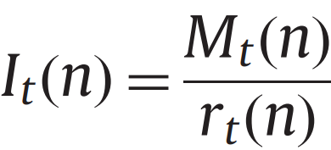
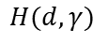
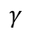
Step 3
Irregularity Detection
$$H(d,γ)$$
1
$$γ$$

Slide 18
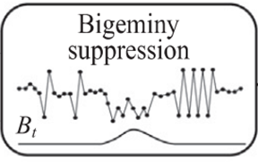
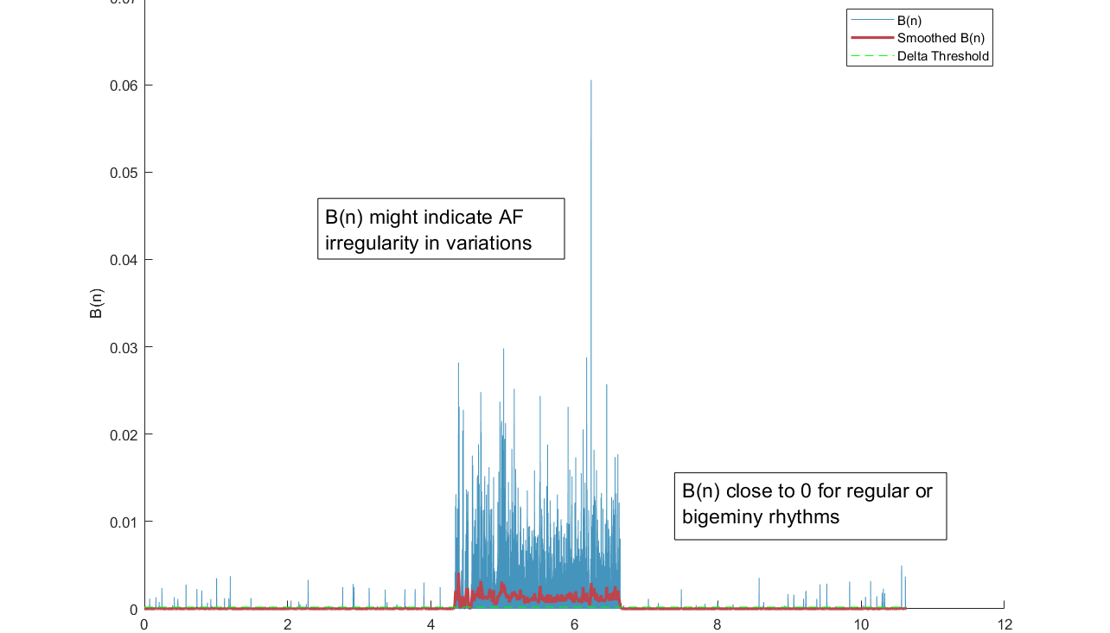
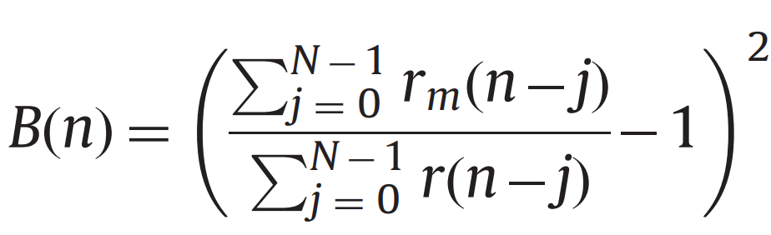
Step 3
Bigeminy Suppression

Slide 19
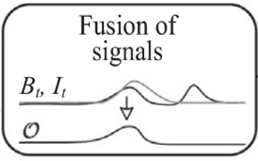
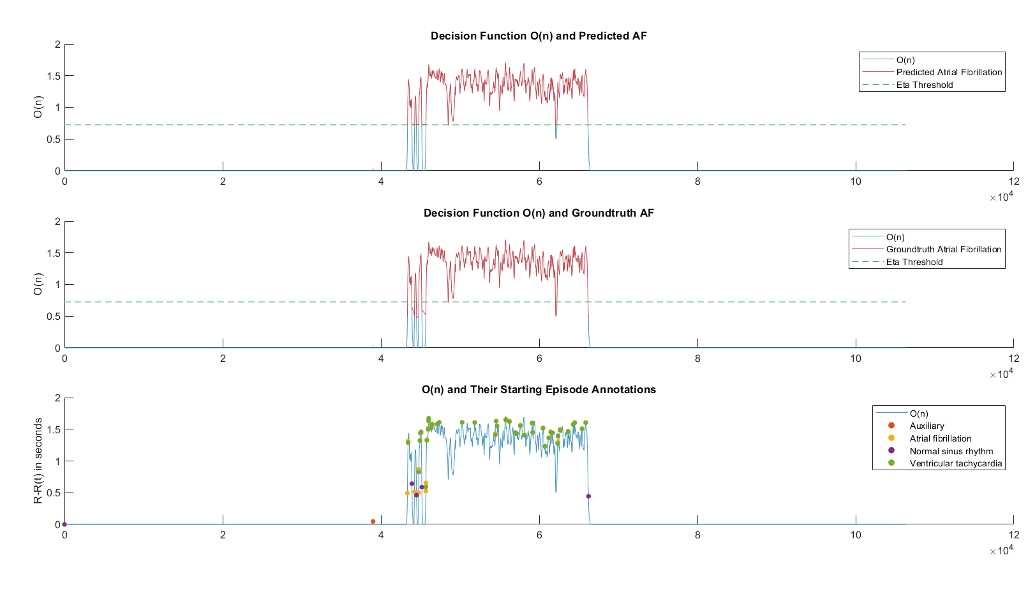
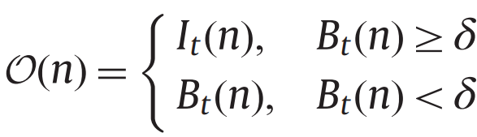
Step 3
Signal Fusion and Detection

Slide 20
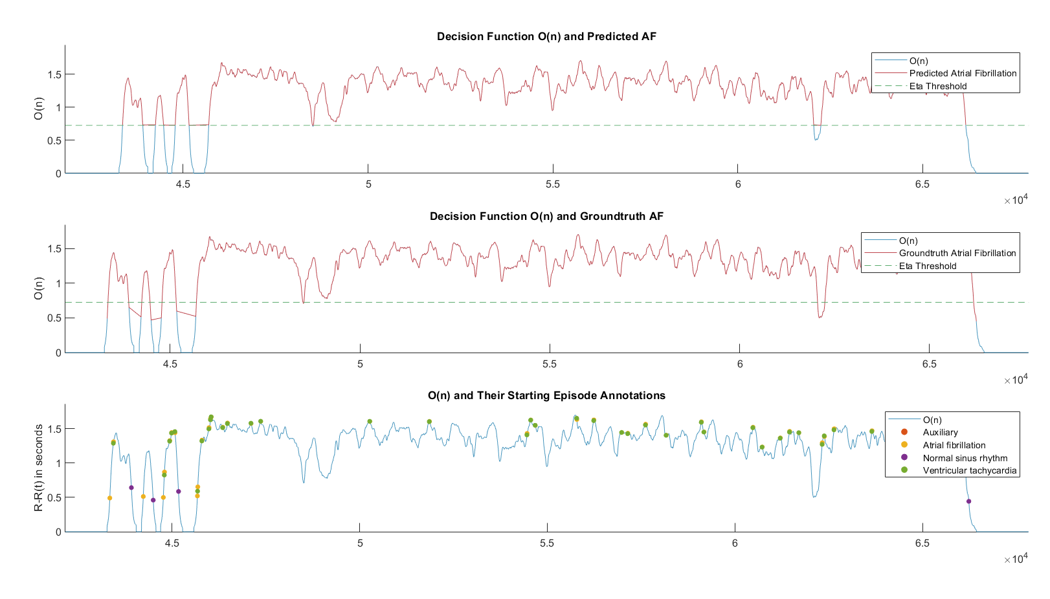
Step 3
Signal Fusion and Detection
How Good Does It
Actually Work?

Slide 21
How Good Does It
Actually Work?

Slide 22
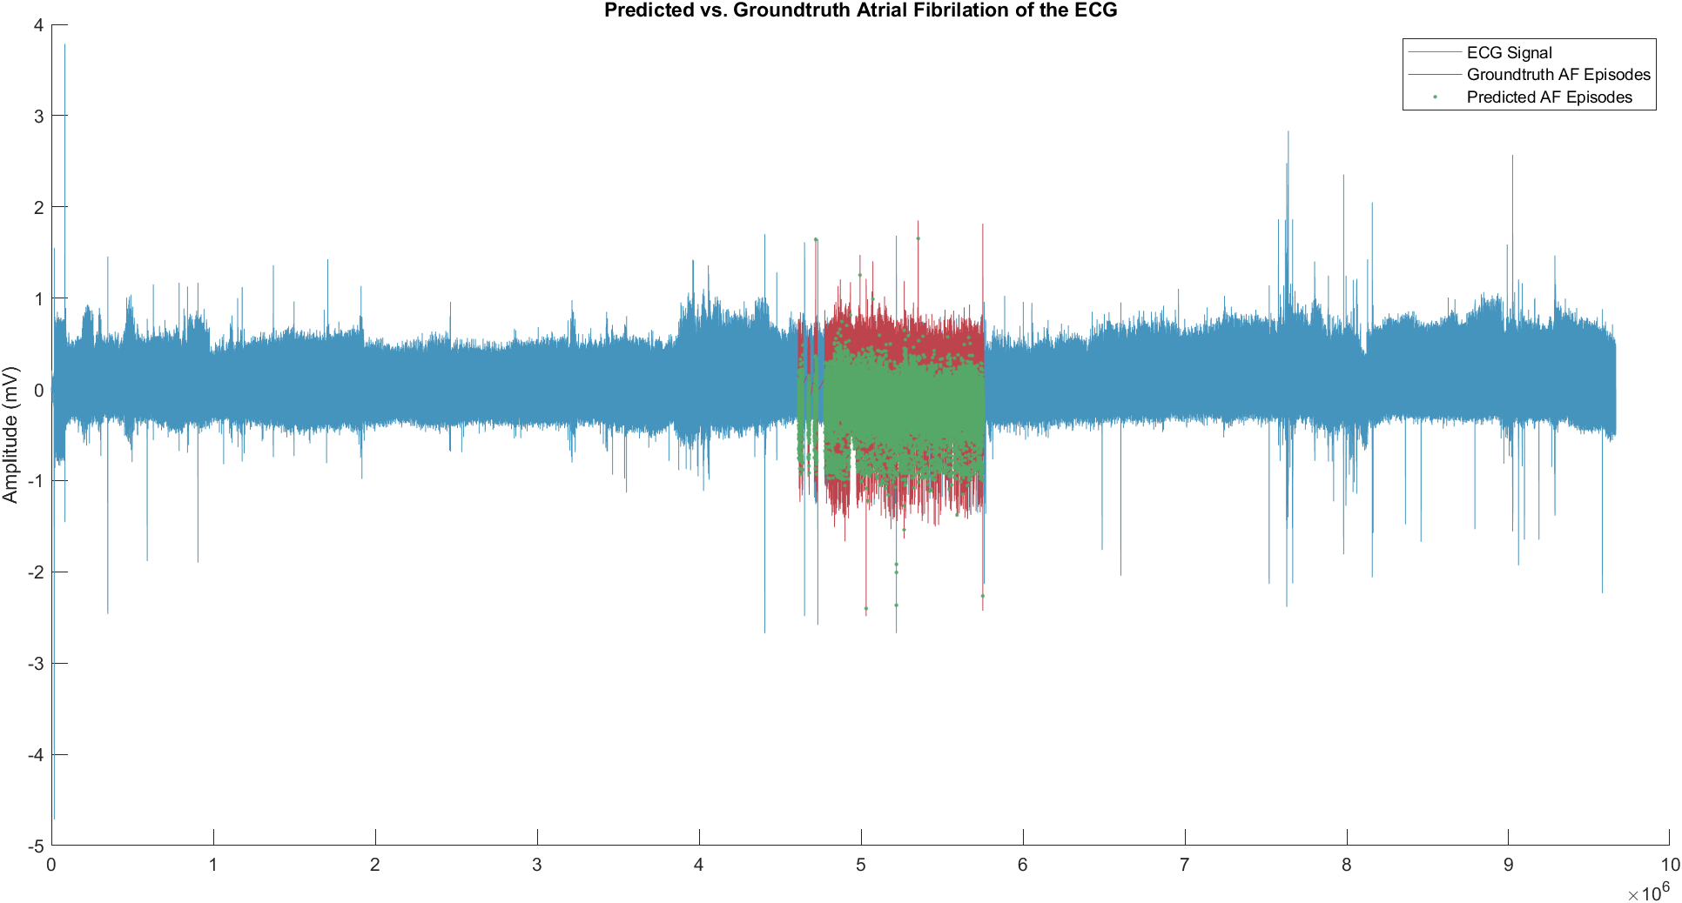
How Good Does It
Actually Work?

Slide 23
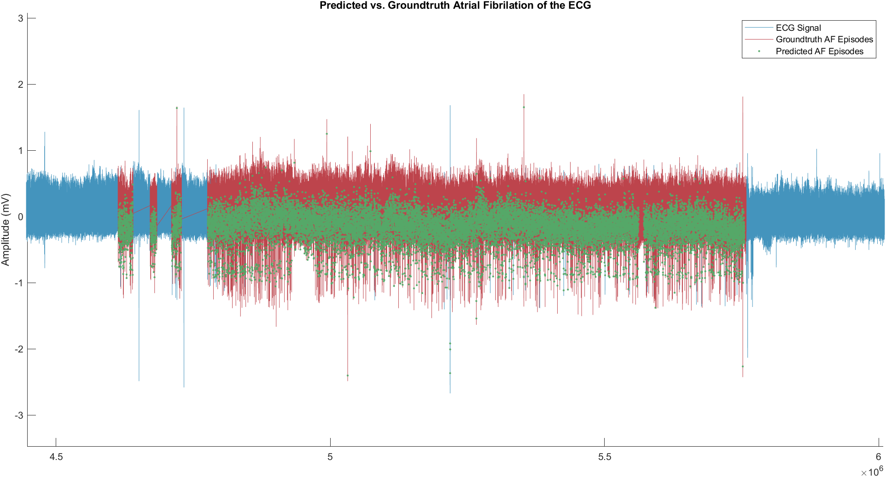
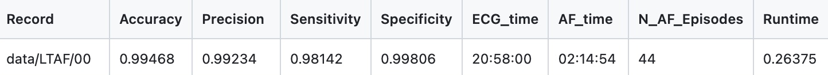

Slide 24
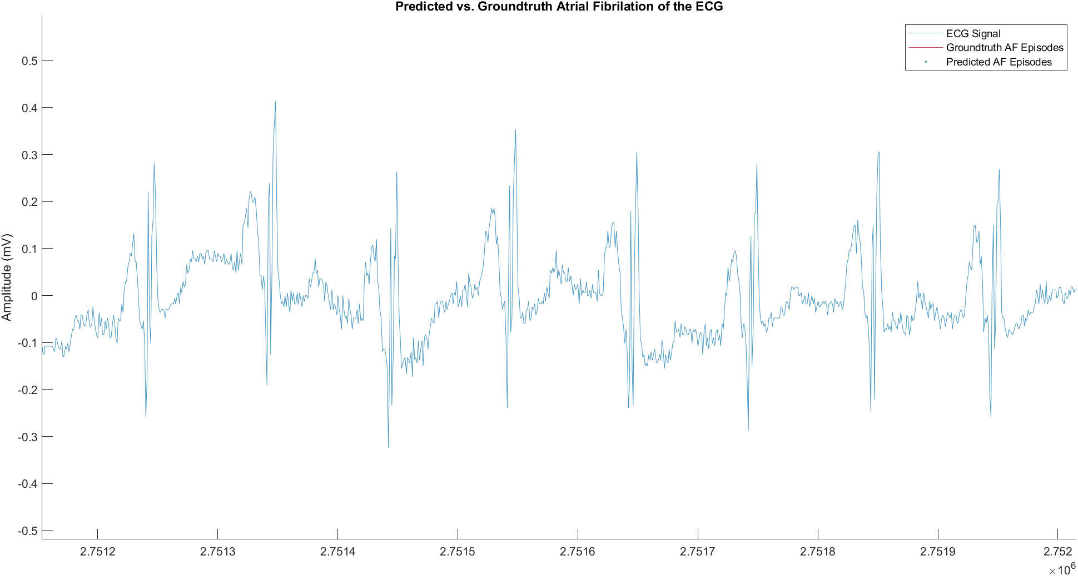

Slide 25
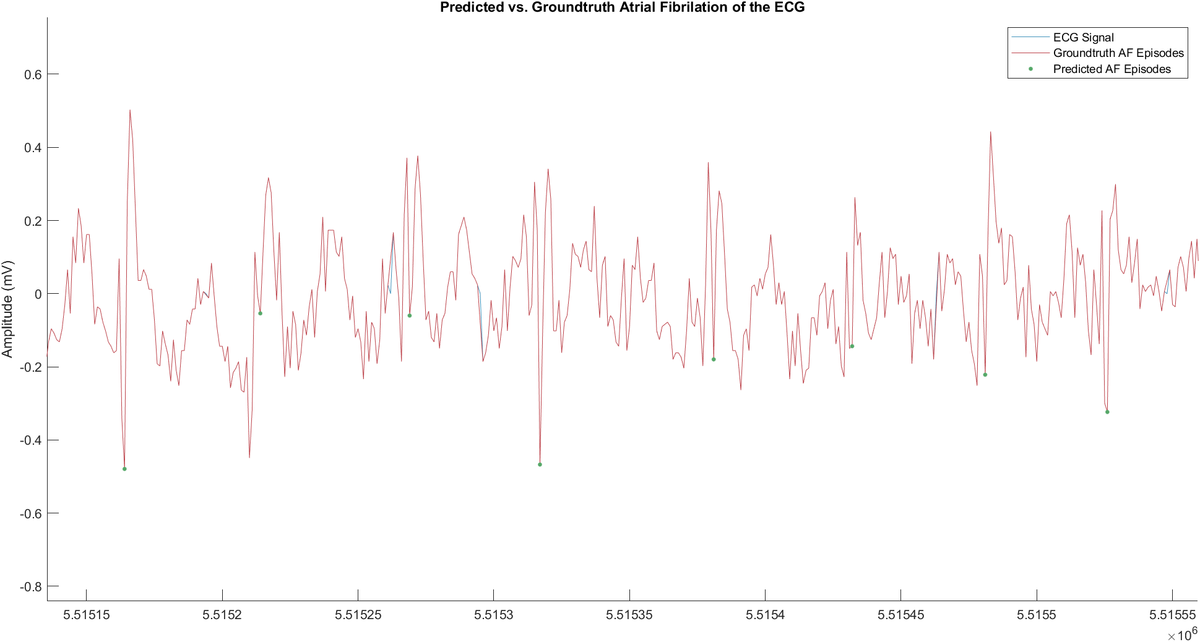

Slide 26
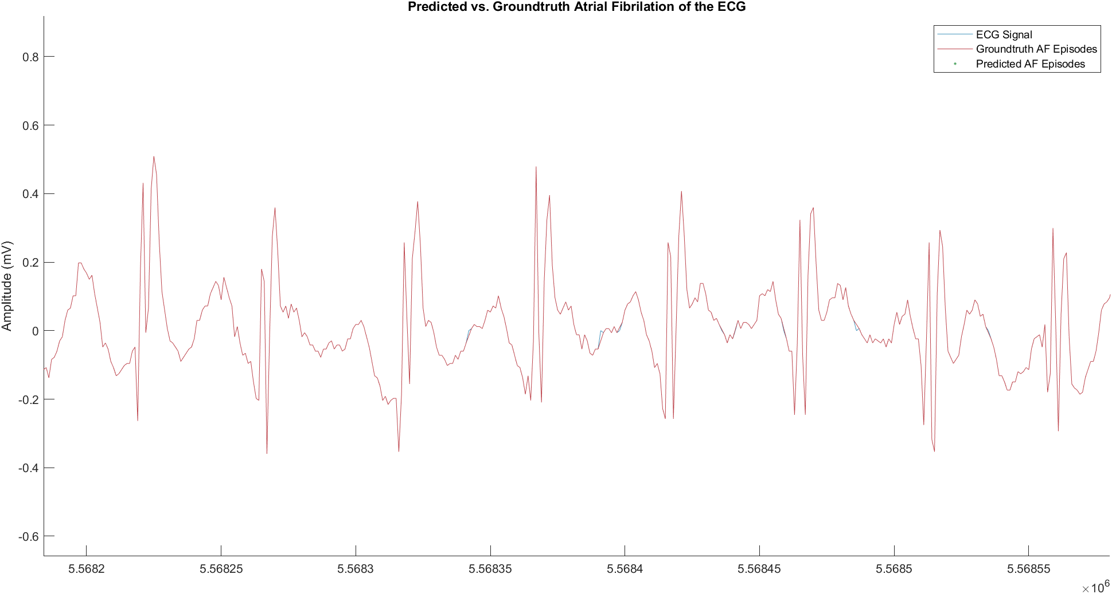
Always THAT good?

Slide 27
Always THAT good?

Slide 28
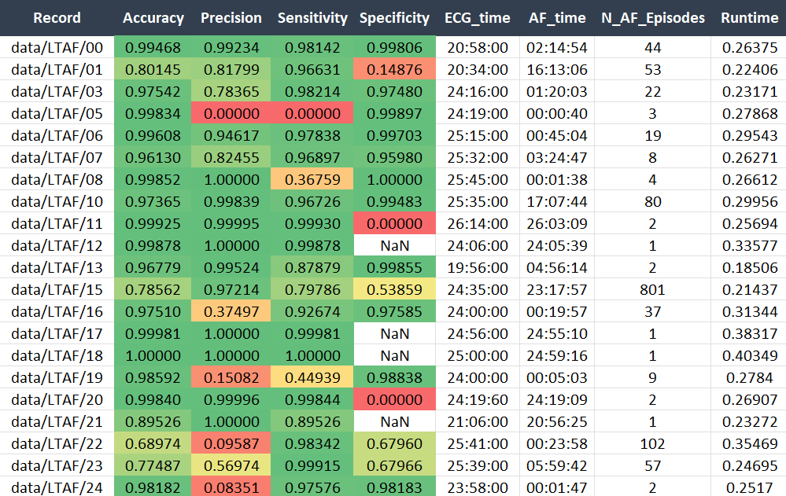
How Good Does It
Actually Work?

Slide 29
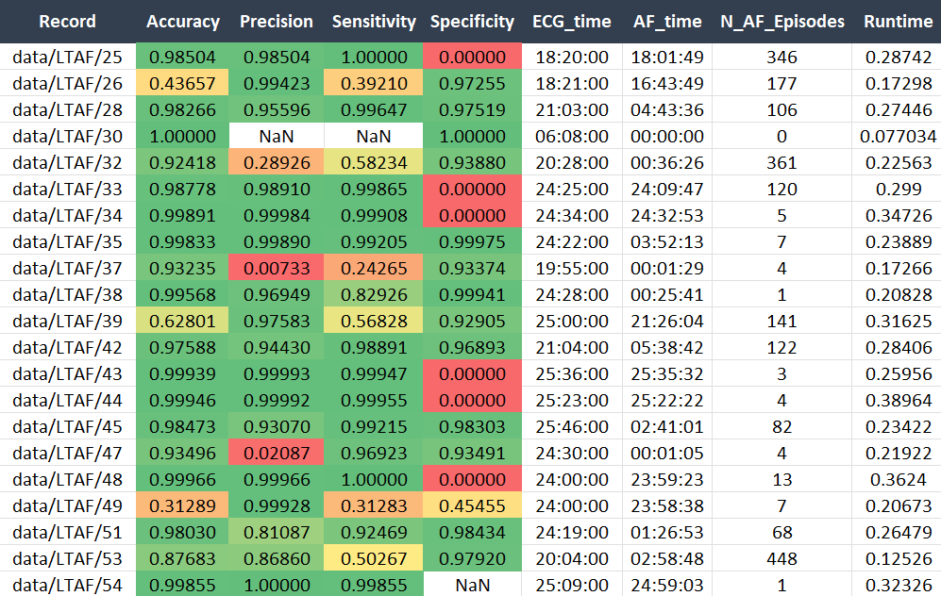
How Good Does It
Actually Work?

Slide 30
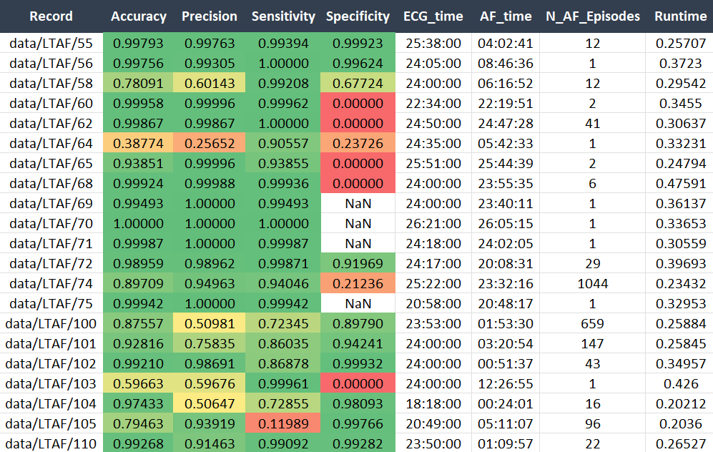
How Good Does It
Actually Work?

Slide 31
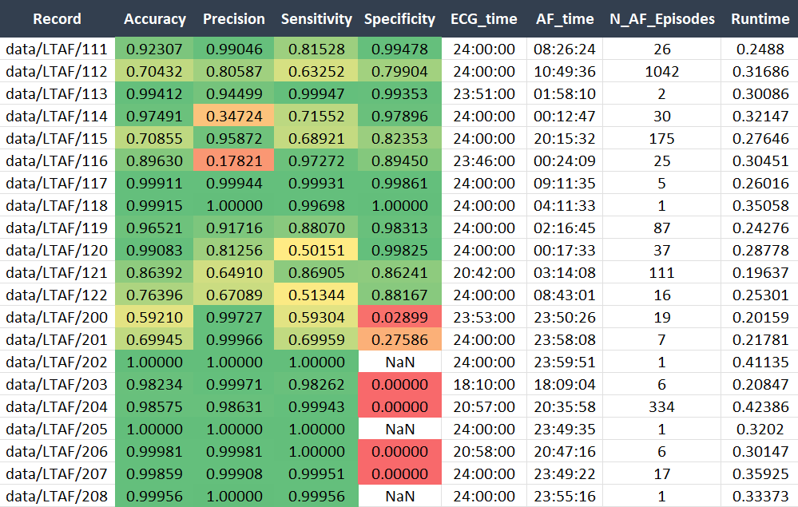
How Good Does It
Actually Work?
Thank you for listening!
Any questions?

Slide 32
References
S. Petrutiu, A.V. Sahakian, S. Swiryn, Abrupt changes in fibrillatory wave characteristics at the termination of paroxysmal atrial fibrillation in humans, Europace 9 (2007) 466–470
A.L. Goldberger, L.A. Amaral, L. Glass, J.M. Hausdorff, P.C. Ivanov, R.G. Mark, J.E. Mietus, G.B. Moody, C.K. Peng, H.E. Stanley, PhysioBank, PhysioToolkit, and PhysioNet: components of a new research resource for complex physiologic signals, Circulation 101 (2000) E215–E220
A. Petrėnas, V. Marozas, L. Sörnmo, Low-complexity detection of atrial fibrillation in continuous long-term monitoring, Computers in Biology and Medicine, 65, 184-191, 2015
Thank you for listening!
Any questions?

Slide 33
References
S. Petrutiu, A.V. Sahakian, S. Swiryn, Abrupt changes in fibrillatory wave characteristics at the termination of paroxysmal atrial fibrillation in humans, Europace 9 (2007) 466–470
A.L. Goldberger, L.A. Amaral, L. Glass, J.M. Hausdorff, P.C. Ivanov, R.G. Mark, J.E. Mietus, G.B. Moody, C.K. Peng, H.E. Stanley, PhysioBank, PhysioToolkit, and PhysioNet: components of a new research resource for complex physiologic signals, Circulation 101 (2000) E215–E220
A. Petrėnas, V. Marozas, L. Sörnmo, Low-complexity detection of atrial fibrillation in continuous long-term monitoring, Computers in Biology and Medicine, 65, 184-191, 2015
Thank you for listening!
Any questions?

